Slide 1
Epileptic Seizure Detection in Continuous EEG
BM 4151 Biosignal Processing

Slide 2
Objective
Detect epileptic seizure events in continuous EEG
Use signal analysis techniques to extract features
Develop a classification algorithm with high accuracy
Use dimensionality reduction for robust computation
Use manual and automatic feature extraction
Minimize the number of false detections
Defined as detecting 2 consecutive windows being detected as seizures

Slide 3
Dataset
CHB-MIT Scalp EEG Database in physionet.org ^{[1]}
EEG data for 23 patients, average of 40 hours for each patient
Sampling rate – 256Hz
23 EEG channels
International 10-20 system of EEG electrode positions
[1] Goldberger AL, Amaral LAN, Glass L, Hausdorff JM, Ivanov PCh, Mark RG, Mietus JE, Moody GB, Peng C-K, Stanley HE. PhysioBank, PhysioToolkit, and PhysioNet: Components of a New Research Resource for Complex Physiologic Signals. Circulation 101(23):e215-e220 [Circulation Electronic Pages; http://circ.ahajournals.org/cgi/content/full/101/23/e215]; 2000 (June 13).

Slide 4
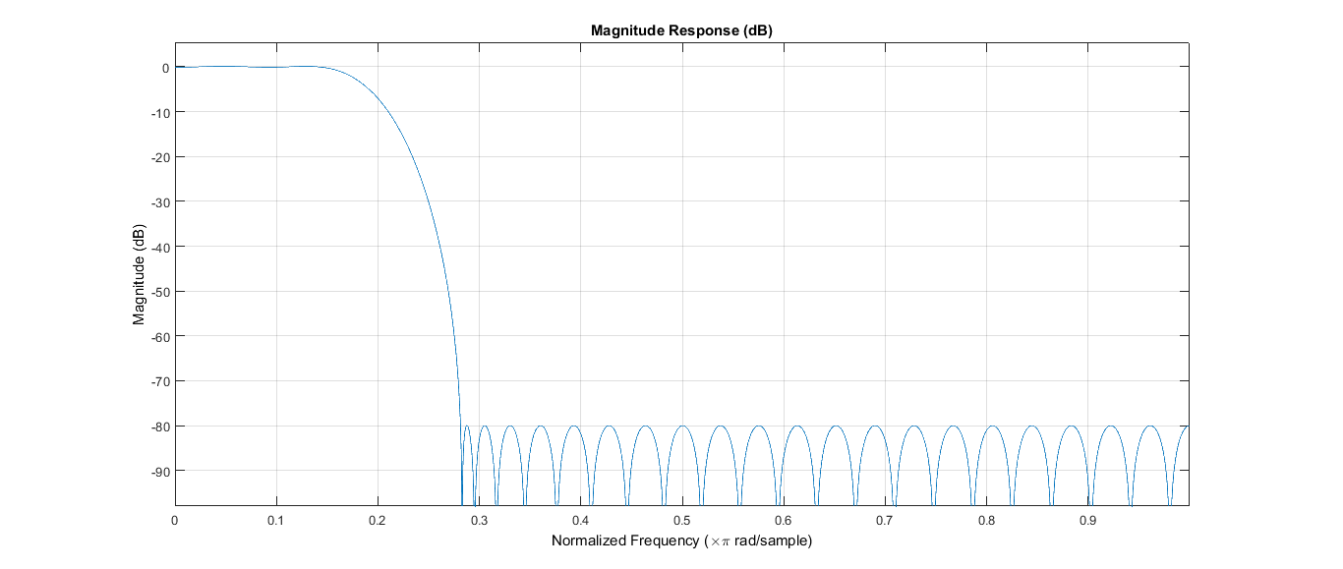
Spectral Analysis
Prior research indicates that spectral characteristics can be used to classify seizure events
The bands 0-16Hz and 16-25Hz are prominent
Preprocessing
A low pass filter with a cut-off frequency of 25Hz and order of 50

Slide 5
Spectral Analysis
Feature Extraction
Spatial features – Manual selection (16 visually significant channels)
Frequency features - Powers of 0-16Hz and 16-25Hz
Temporal features – STFT with non-overlapping 4s window
Classifier
SVM classifier with Radial Basis Function kernel
Training Data
65 seizure windows for cross validation
22 seizure windows for testing
41 seizure windows for testing
1000 non seizure windows in both instances

Slide 6
Spectral Analysis
Statistics of Patient 01
65 seizure windows at 5 instances (11, 7, 11, 13, 23)
20 hours of data were considered
Results – Cross Validation
58 seizure windows out of 65 (accuracy ≈ 90%)
First window or two of the seizure events were missed by the classifier
8 false detections of onset (0.4h⁻¹)
Average latency – 5.4s
Can be improved by a sliding overlapping window

Slide 7
Spectral Analysis
Results – Training with 2 instances (22 seizure windows)
37 seizure windows out of 65 (accuracy ≈ 58%)
First window or two of the seizure events were missed by the classifier
Regions within the seizure were missed by the classifier
4 false detections of onset (0.2h⁻¹)
Average latency – 6.4s

Slide 8
Spectral Analysis
Results – Training with 3 instances (41 seizure windows)
50 seizure windows out of 65 (accuracy ≈ 77%)
First window or two of the seizure events were missed by the classifier
Regions within the seizure were missed by the classifier
7 false detections of onset (0.35h⁻¹)
Average latency – 5.4s

Slide 9
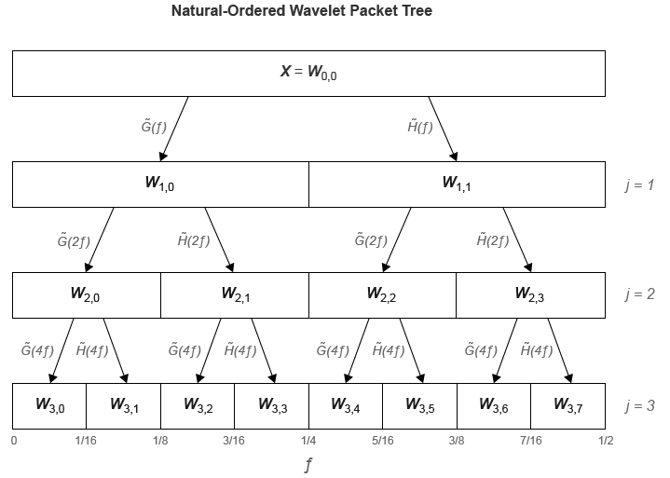
Wavelet Analysis
Discrete Wavelet Packet Transform – DWPT
Improvement of DWT which represents more temporal and frequency information

Slide 10
Wavelet Analysis
Pre-processing
Low pass filter similar to spectral analysis
Feature extraction
Wavelet packet decomposition
5 levels
Daubechies wavelet family – db4
Obtain mean power of each packet (23 x 32 features)
Temporal features – Non-overlapping window of 4s

Slide 11
Wavelet Analysis
Dimensionality Reduction
One-way ANOVA to obtain features with maximum significance (maximum p-value between seizure and non-seizure events)
Dimensions reduced to 4
Classifier – Similar to spectral analysis

Slide 12
Wavelet Analysis
Results – Cross Validation
58 seizure windows out of 65 (accuracy ≈ 90%)
First window or two of the seizure events were missed by the classifier – Similar to earlier instance
7 false detections of onset (0.35h⁻¹)
Average latency – 2.4s
Can be improved by a sliding overlapping window

Slide 13
Wavelet Analysis
Results – Training with 2 instances (22 seizure windows)
44 seizure windows out of 65 (accuracy ≈ 68%)
First window or two of the seizure events were missed by the classifier – Similar to earlier instance
2 false detections of onset (0.1h⁻¹)
Average latency – 5s

Slide 14
Wavelet Analysis
Results – Training with 3 instances (41 seizure windows)
56 seizure windows out of 65 (accuracy ≈ 86%)
First window or two of the seizure events were missed by the classifier – Similar to earlier instance
2 false detections of onset (0.1h⁻¹)
Average latency – 4s

Slide 15
Discussion
Both approaches yield similar cross validation accuracies
DWPT based method yields high accuracy (90%) for less training data
High accuracy using very small number of features in DWPT
Low latency in DWPT method

Slide 16
Improvements
Use other classifying methods
Further decrease features and maintain accuracy
Achieve even more accuracy
Introduce a correlation based feature extraction method
Test for variable window sizes and overlapping windows to reduce latency

